Slide 1
Information Extraction from Twitter
Fred Morstatter
fredmors@isi.edu

Slide 2








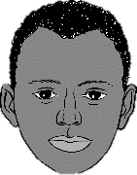






Nuances in Social Media
Platform Data
The World
Social Media
1
2
Notes:
Bots can be overrepresented in social samples.

Slide 3
Why Twitter?
Collected all papers from ICWSM 2010 – 2017.
843 papers total.

Slide 4

Information Extraction: Motivation
Status Updates = short realtime messages
Low Overhead: Can be created quickly
Even on mobile devices
Realtime: users report events in progress
Often the most up-to date source of information
Huge Volume of Users
People Tweet about things they find interesting
Can use redundancy as a measure of importance
Some slides adapted from Ritter et al. 2012

Slide 5
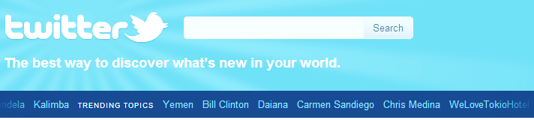
Information Extraction: Motivation
Status Updates = short realtime messages
Low Overhead: Can be created quickly
Even on mobile devices
Realtime: users report events in progress
Often the most up-to date source of information
Huge Volume of Users
People Tweet about things they find interesting
Can use redundancy as a measure of importance

Slide 6
Outline
Motivation
Error Analysis of Off The Shelf Tools
POS Tagger
Named Entity Segmentation
Named Entity Classification
Distant Supervision Using Topic Models
Other considerations for Twitter

Slide 7
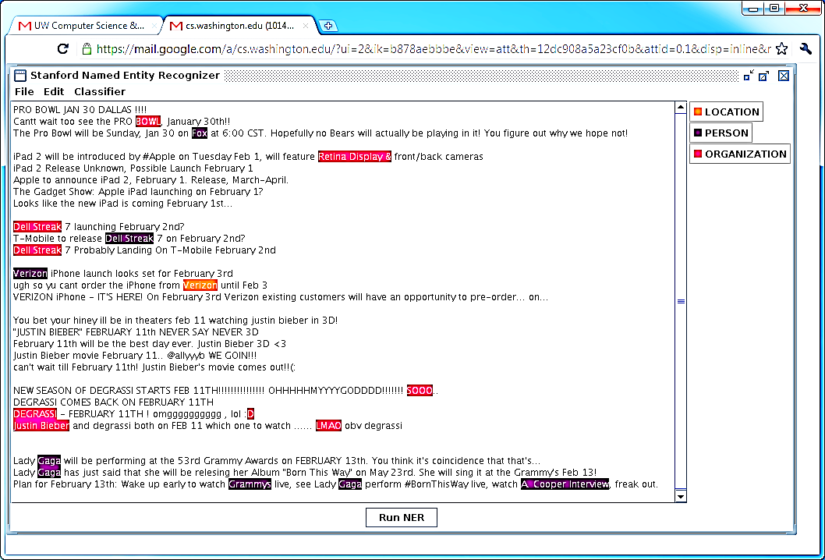
Off The Shelf NLP Tools Fail
Notes:
Talk about false negatives!

Slide 8
Off The Shelf NLP Tools Fail
Twitter Has Noisy & Unique Style

Slide 9
Noisy Text: Challenges
Lexical Variation (misspellings, abbreviations)
`2m', `2ma', `2mar', `2mara', `2maro', `2marrow', `2mor', `2mora', `2moro', `2morow', `2morr', `2morro', `2morrow', `2moz', `2mr', `2mro', `2mrrw', `2mrw', `2mw', `tmmrw', `tmo', `tmoro', `tmorrow', `tmoz', `tmr', `tmro', `tmrow', `tmrrow', `tmrrw', `tmrw', `tmrww', `tmw', `tomaro', `tomarow', `tomarro', `tomarrow', `tomm', `tommarow', `tommarrow', `tommoro', `tommorow', `tommorrow', `tommorw', `tommrow', `tomo', `tomolo', `tomoro', `tomorow', `tomorro', `tomorrw', `tomoz', `tomrw', `tomz‘
Unreliable Capitalization
“The Hobbit has FINALLY started filming! I cannot wait!”
Unique Grammar
“watchng american dad.”

Slide 10
Reminder: NER
Named Entity Recognition
Named Entities:
Words or phrases which reference an object.
[Jim] bought 300 shares of [Acme Corp.] in [2006]
Recognition:
Categorizing them.
[Jim]_{Person} bought 300 shares of [Acme Corp.]_{Organization} in [2006]_{Time}

Slide 11
Part of speech tagging

Slide 12
Part Of Speech Tagging: Accuracy Drops on Tweets
Most Common Tag: 76% (90% on brown corpus)
Stanford POS: 80% (97% on news)
Notes:
Prior experiments have suggested that POS tagging has a very strong baseline: assign each word to its most frequent tag and assign each Out of Vocabulary (OOV) word the most common POS tag.

Slide 13
Part Of Speech Tagging: Accuracy Drops on Tweets
Most Common Tag: 76% (90% on brown corpus)
Stanford POS: 80% (97% on news)
Most Common Errors:
Confusing Common/Proper nouns
Misclassifying interjections as nouns
Misclassifying verbs as nouns

Slide 14
POS Tagging
Labeled 800 tweets w/ POS tags
About 16,000 tokens
Also used labeled news + IRC chat data (Forsyth and Martell 07)
CRF on standard set of features
Contextual
Dictionary
Orthographic

Slide 15
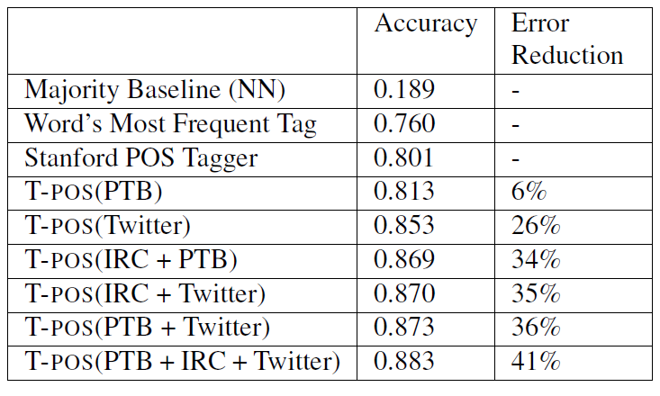
Results

Slide 16
XX/YY = XX is misclassified as YY

Slide 17
Named Entity Segmentation
Off the shelf taggers perform poorly
Stanford NER: F1=0.44
not including classification

Slide 18
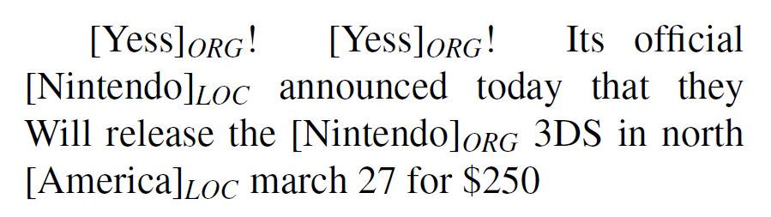
Named Entity Segmentation
Off the shelf taggers perform poorly
Stanford NER: F1=0.44
not including classification

Slide 19
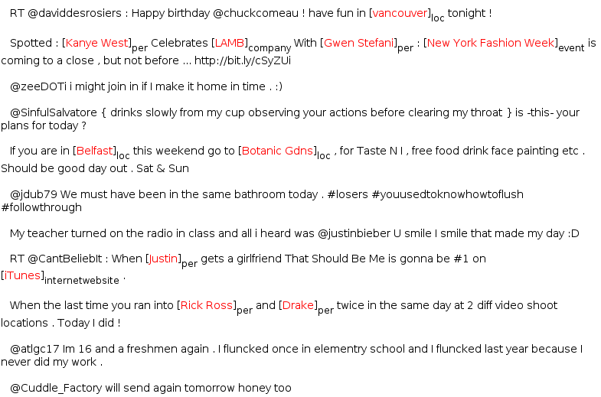
Annotating Named Entities
Annotated 2400 tweets (about 34K tokens)
Train on in-domain data

Slide 20
Learning
Sequence Labeling Task
IOB encoding
Conditional Random Fields
Features:
Orthographic
Dictionaries
Contextual
Word | Label
T-Mobile | B-ENTITY
to | O
release | O
Dell | B-ENTITY
Streak | I-ENTITY
7 | I-ENTITY
on | O
Feb | O
2nd | O

Slide 21
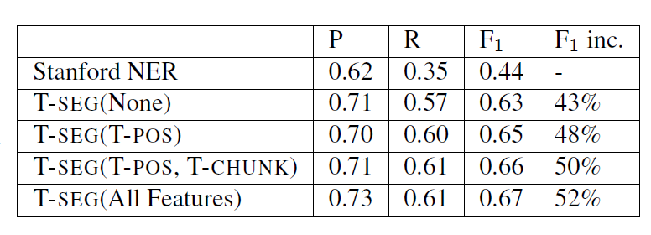
Performance (Segmentation Only)

Slide 22
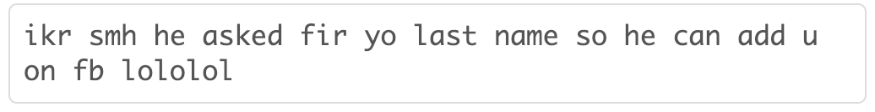
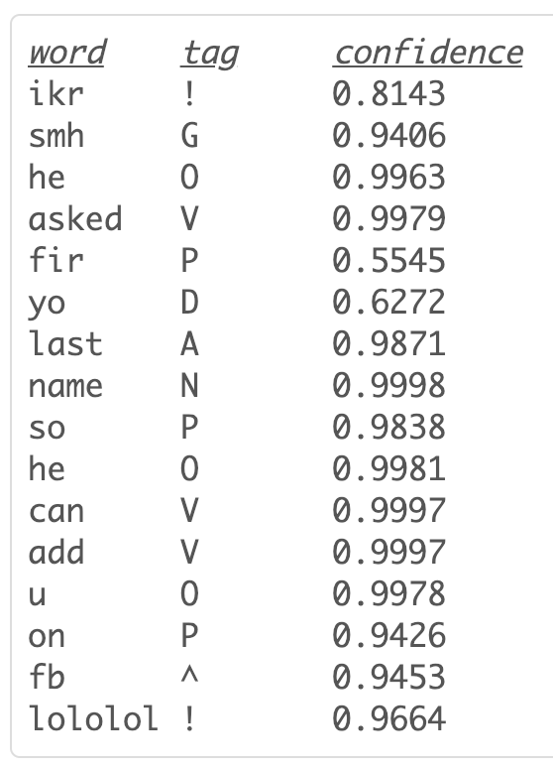
Aside: New Tag Set
Real Tweet:
25 tags
36 in Penn Treebank
Owoputi, Olutobi, et al. "Part-of-speech tagging for Twitter: Word clusters and other advances." School of Computer Science (2012).

Slide 23
Named Entity Classification

Slide 24
Challenges
Plethora of distinctive, infrequent types
Bands, Movies, Products, etc…
Very little training data for these
Can’t simply rely on supervised classification
Very terse (often contain insufficient context)

Slide 25
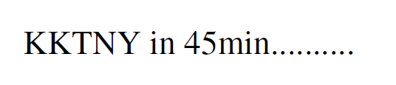
Challenges
Plethora of distinctive, infrequent types
Bands, Movies, Products, etc…
Very little training data for these
Can’t simply rely on supervised classification
Very terse (often contain insufficient context)
Notes:
Kourtney and Kim Take New York

Slide 26
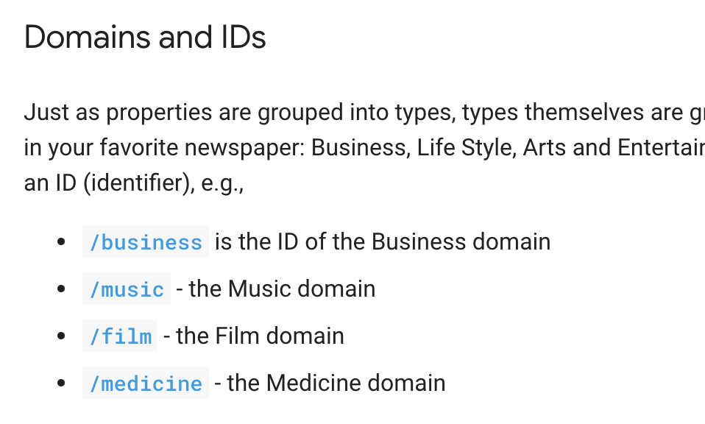
Freebase!
“A massive, collaboratively edited database of cross-linked data”
Wikipedia-turned-database
Notes:
Bob Dylan was a song writer, singer, performer, book author, and film actor

Slide 27
Weakly Supervised NE Classification (Collins and Singer 99) (Etzioni et. al. 05) (Kozareva 06)
Freebase lists provide a source of supervision
But entities often appear in many different lists, for example “China” could be:
A country
A band
A person (member of the band “metal boys”)
A film (released in 1943)

Slide 28
Weakly Supervised NE Classification (Collins and Singer 99) (Etzioni et. al. 05) (Kozareva 06)
Freebase lists provide a source of supervision
But entities often appear in many different lists, for example “China” could be:
A country
A band
A person (member of the band “metal boys”)
A film (released in 1943)
We need Some way to disambiguate

Slide 29
Distant Supervision With Topic Models
Treat each entity as a “document”
Words in document are those which co-occur with entity
LabeledLDA (Ramage et. al. 2009)
Constrained Topic Model
Each entity is associated with a distribution over topics
Constrained based on FB dictionaries
Each topic is associated with a type (in Freebase)

Slide 30
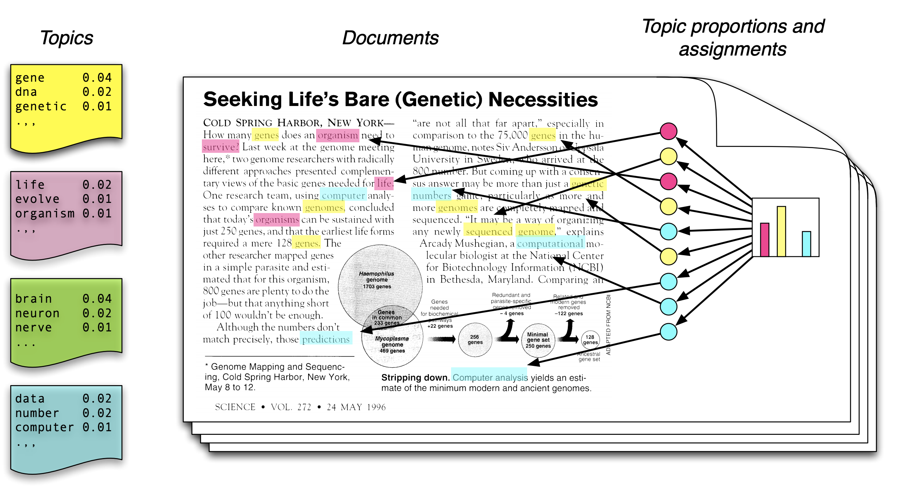
LDA

Slide 31
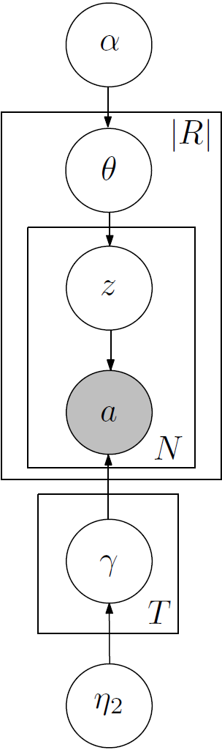
Generative Story

Slide 32
Generative Story
For each type, pick a random distribution over words

Slide 33
Generative Story
For each type, pick a random distribution over words
Type 1: TEAM
P(victory|T1)= 0.02
P(played|T1)= 0.01
…
Type 2: LOCATION
P(visiting|T2)=0.05
P(airport|T2)=0.02
…

Slide 34
Generative Story
For each entity, pick a distribution over types (constrained by Freebase)
For each type, pick a random distribution over words
Type 1: TEAM
P(victory|T1)= 0.02
P(played|T1)= 0.01
…
Type 2: LOCATION
P(visiting|T2)=0.05
P(airport|T2)=0.02
…

Slide 35
Generative Story
For each entity, pick a distribution over types (constrained by Freebase)
Seattle
P(TEAM|Seattle)= 0.6
P(LOCATION|Seattle)= 0.4
For each type, pick a random distribution over words
Type 1: TEAM
P(victory|T1)= 0.02
P(played|T1)= 0.01
…
Type 2: LOCATION
P(visiting|T2)=0.05
P(airport|T2)=0.02
…

Slide 36
Generative Story
For each entity, pick a distribution over types (constrained by Freebase)
Seattle
P(TEAM|Seattle)= 0.6
P(LOCATION|Seattle)= 0.4
For each position, first pick a type
For each type, pick a random distribution over words
Type 1: TEAM
P(victory|T1)= 0.02
P(played|T1)= 0.01
…
Type 2: LOCATION
P(visiting|T2)=0.05
P(airport|T2)=0.02
…

Slide 37
Generative Story
For each entity, pick a distribution over types (constrained by Freebase)
Seattle
P(TEAM|Seattle)= 0.6
P(LOCATION|Seattle)= 0.4
For each position, first pick a type
Is a TEAM
For each type, pick a random distribution over words
Type 1: TEAM
P(victory|T1)= 0.02
P(played|T1)= 0.01
…
Type 2: LOCATION
P(visiting|T2)=0.05
P(airport|T2)=0.02
…

Slide 38
Generative Story
For each entity, pick a distribution over types (constrained by Freebase)
Seattle
P(TEAM|Seattle)= 0.6
P(LOCATION|Seattle)= 0.4
For each position, first pick a type
Is a TEAM
Then pick an word based on type
For each type, pick a random distribution over words
Type 1: TEAM
P(victory|T1)= 0.02
P(played|T1)= 0.01
…
Type 2: LOCATION
P(visiting|T2)=0.05
P(airport|T2)=0.02
…

Slide 39
Generative Story
For each entity, pick a distribution over types (constrained by Freebase)
Seattle
P(TEAM|Seattle)= 0.6
P(LOCATION|Seattle)= 0.4
For each position, first pick a type
Is a TEAM
Then pick an word based on type
victory
For each type, pick a random distribution over words
Type 1: TEAM
P(victory|T1)= 0.02
P(played|T1)= 0.01
…
Type 2: LOCATION
P(visiting|T2)=0.05
P(airport|T2)=0.02
…

Slide 40
Generative Story
For each entity, pick a distribution over types (constrained by Freebase)
Seattle
P(TEAM|Seattle)= 0.6
P(LOCATION|Seattle)= 0.4
For each position, first pick a type
Is a TEAM
Is a LOCATION
Then pick an word based on type
victory
For each type, pick a random distribution over words
Type 1: TEAM
P(victory|T1)= 0.02
P(played|T1)= 0.01
…
Type 2: LOCATION
P(visiting|T2)=0.05
P(airport|T2)=0.02
…

Slide 41
Generative Story
For each entity, pick a distribution over types (constrained by Freebase)
Seattle
P(TEAM|Seattle)= 0.6
P(LOCATION|Seattle)= 0.4
For each position, first pick a type
Is a TEAM
Is a LOCATION
Then pick an word based on type
victory
airport
For each type, pick a random distribution over words
Type 1: TEAM
P(victory|T1)= 0.02
P(played|T1)= 0.01
…
Type 2: LOCATION
P(visiting|T2)=0.05
P(airport|T2)=0.02
…

Slide 42
Data/Inference
Gather entities and words which co-occur
Extract Entities from about 60M status messages
Used a set of 10 types from Freebase
Commonly occur in Tweets
Good coverage in Freebase
Inference: Collapsed Gibbs sampling:
Constrain types using Freebase
For entities not in Freebase, don’t constrain
Notes:
23,425

Slide 43
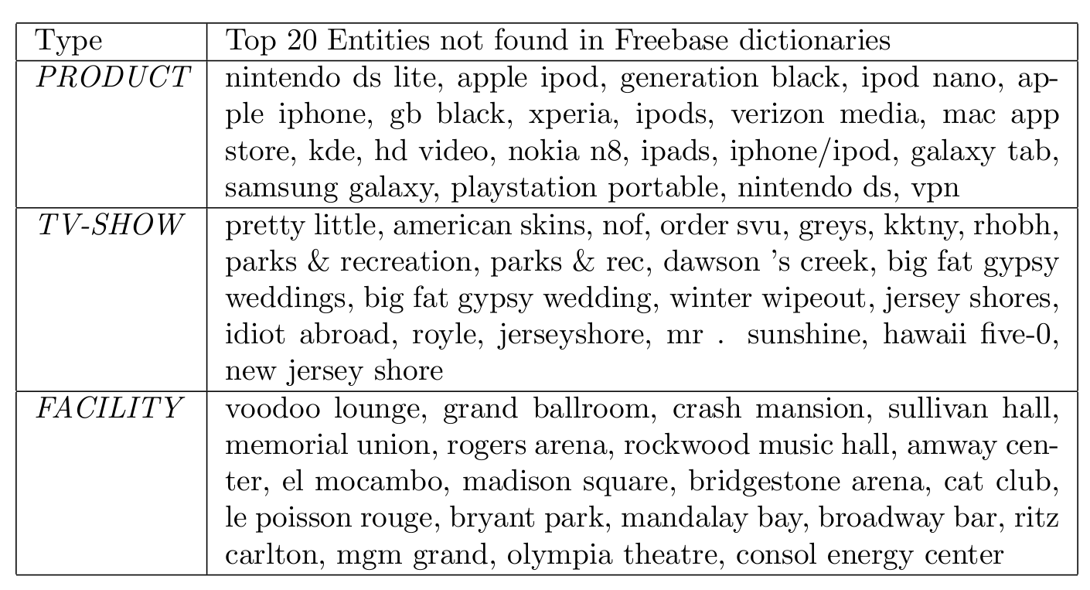
Type Lists

Slide 44
Type Lists
KKTNY = Kourtney and Kim Take New York
RHOBH = Real Housewives of Beverly Hills

Slide 45
Evaluation
Manually Annotated the 2,400 tweets with the 10 entity types
Only used for testing purposes
No labeled examples for LLDA & Cotraining

Slide 46
Classification Results: 10 Types (Gold Segmentation)

Slide 47
Classification Results: 10 Types (Gold Segmentation)
Precision =0.85
Recall=0.24

Slide 48
Classification Results: 10 Types (Gold Segmentation)

Slide 49
Why is LDA winning?
Share type info. across mentions
Unambiguous mentions help to disambiguate
Unlabeled examples provide entity-specific prior
Explicitly models ambiguity
Each “entity string” is modeled as (constrained) distribution over types
Takes better advantage of ambiguous training data

Slide 50
Tools are Available
https://github.com/aritter/twitter_nlp

Slide 51
Generalization
So far we have focused on text.
Just one behavior.
Behaviors are, to a certain degree, imposed by the platform.

Slide 52
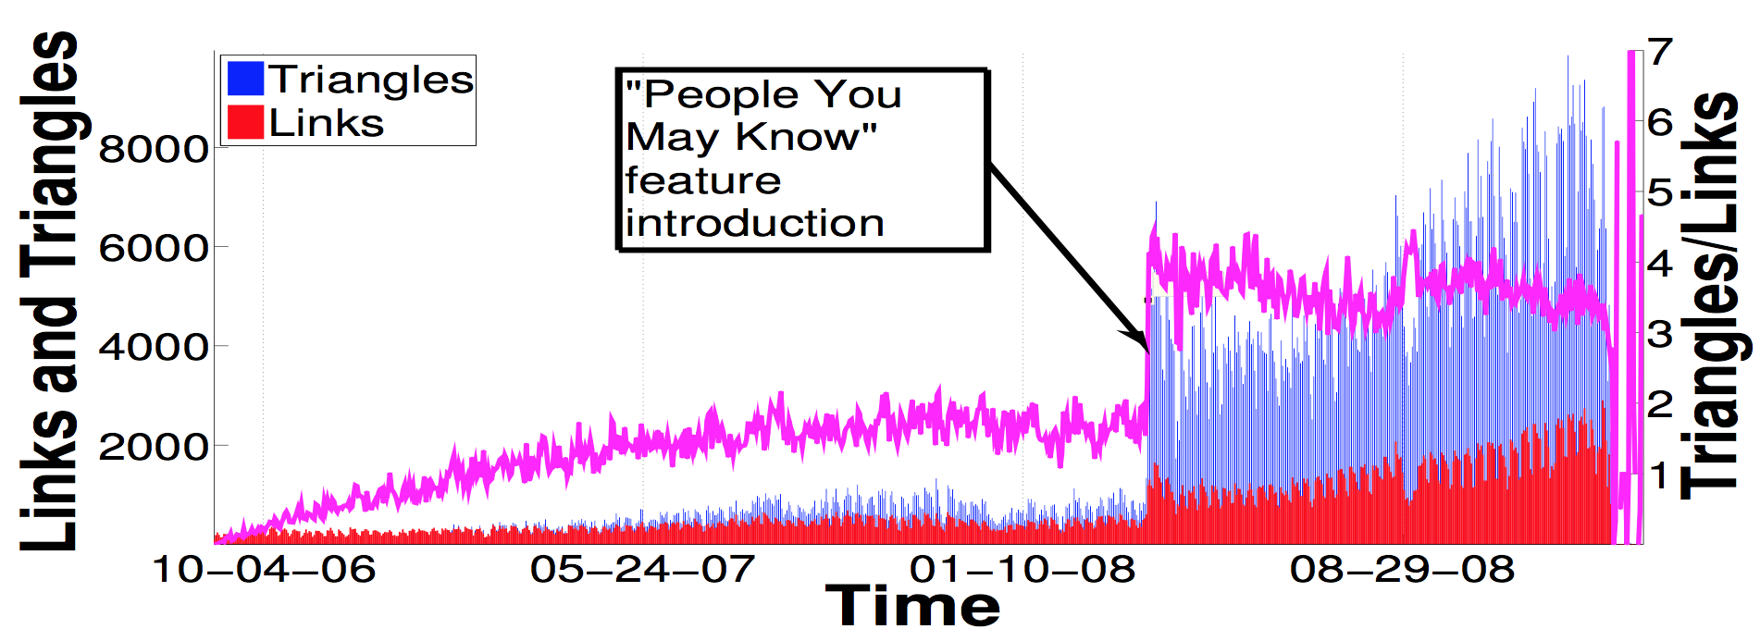
Platform Effects
From: Zignani et al., 2014. Link and triadic closure delay:
Temporal metrics for social network dynamics, ICWSM 2014
Notes:
Magenta line represents the ratio between the triangle and the links created in a day.
Zignani et al., 2014. Link and triadic closure delay: Temporal metrics for social network dynamics, ICWSM 2014

Slide 53
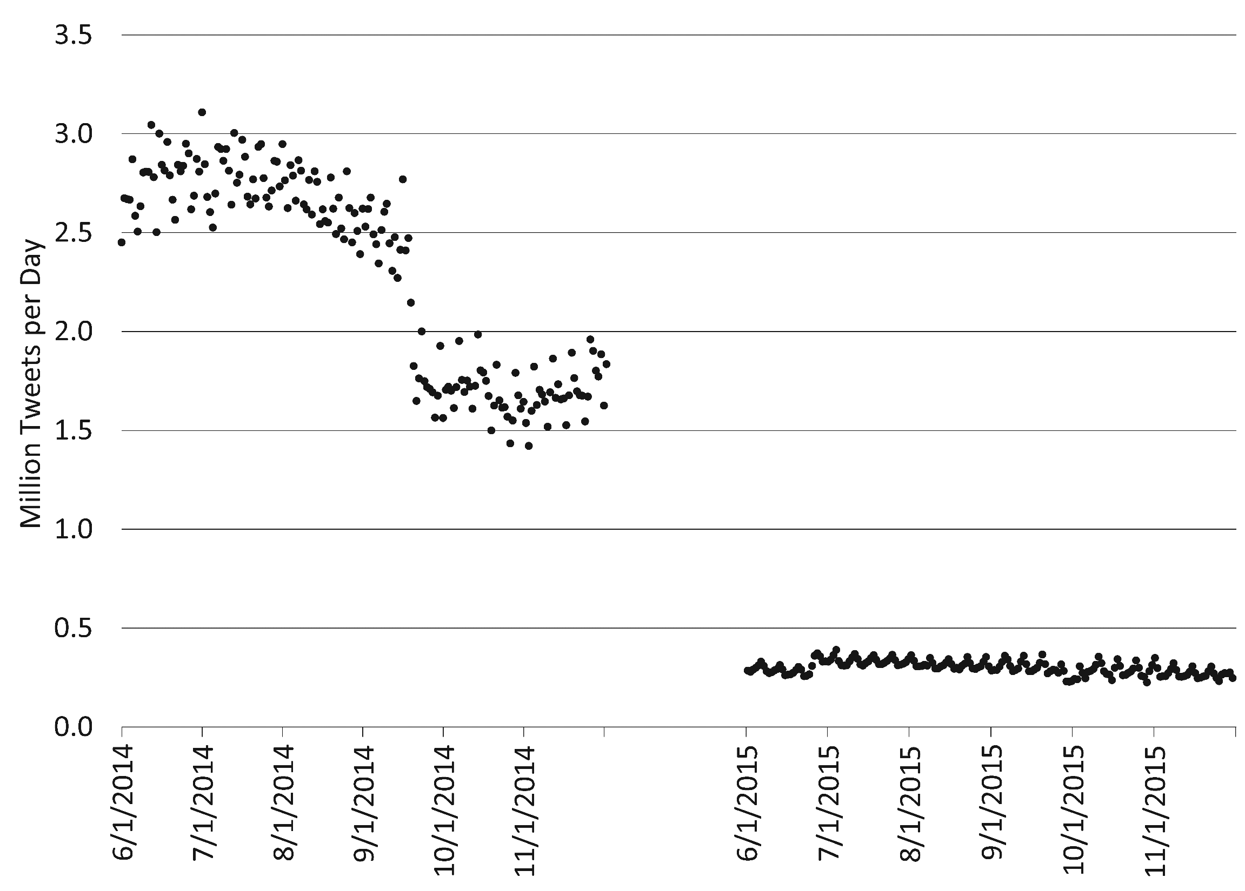
Platform Effects
2014: ~90% of all geo-tagged tweets in geo-box based collections
2015: reduced to 1/10 of volume

Slide 54
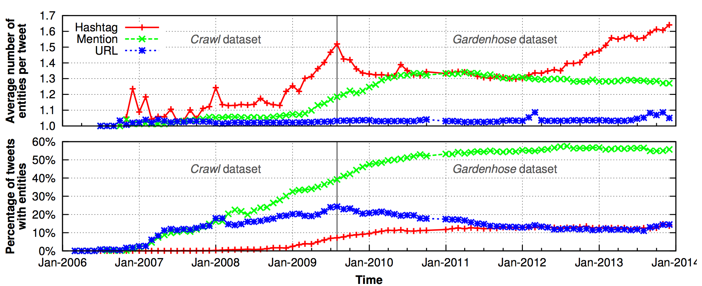
User Base Evolution
As a site gains popularity, its user base changes.
This can also change the way a site is used.
Liu, Yabing, Chloe Kliman-Silver, and Alan Mislove. "The Tweets They Are a-Changin: Evolution of Twitter Users and Behavior." ICWSM. Vol. 30. 2014. 5-314.

Slide 55
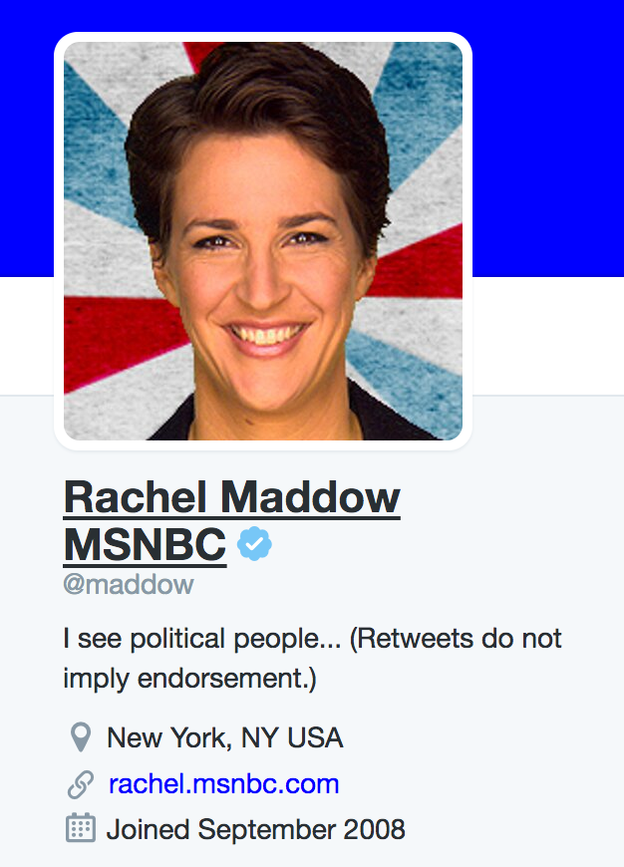
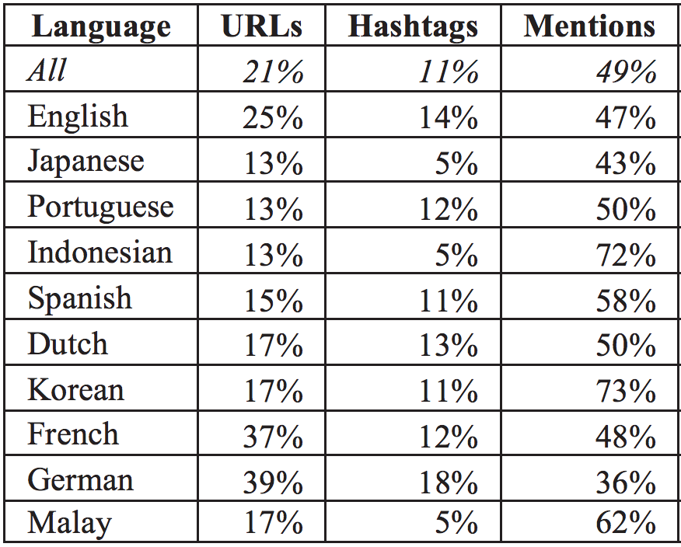
User Base Discrepancies
The user base is not a monolith.
Different communities use the same features differently.
Awareness is key to effectively interpret social media.
Hong, Lichan, Gregorio Convertino, and Ed H. Chi. "Language Matters In Twitter: A Large Scale Study." ICWSM (2011).

Slide 56
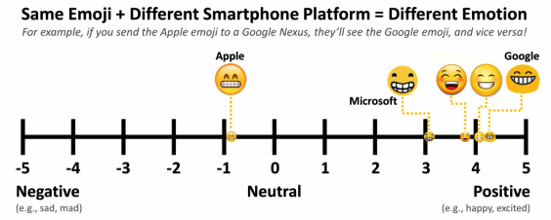
Different Rendering, Different Interpretation
Using Mechanical Turk, authors asked workers to rate their reactions to different emojis.
Miller, Hannah, et al. "Blissfully happy” or “ready to fight”:
Varying Interpretations of Emoji." Proceedings of ICWSM 2016 (2016).

Slide 57
Wrapping Up
Social data analysis has many biases and methodological pitfalls.
Things to watch out for:
Sampling
Direct
Malicious Users
Platform Effects
Nuanced User Behavior (including text)

